Slide 1
Windows 10
Imaging & Deployment
Ben Dumke – Hortonville Area School District

Slide 2
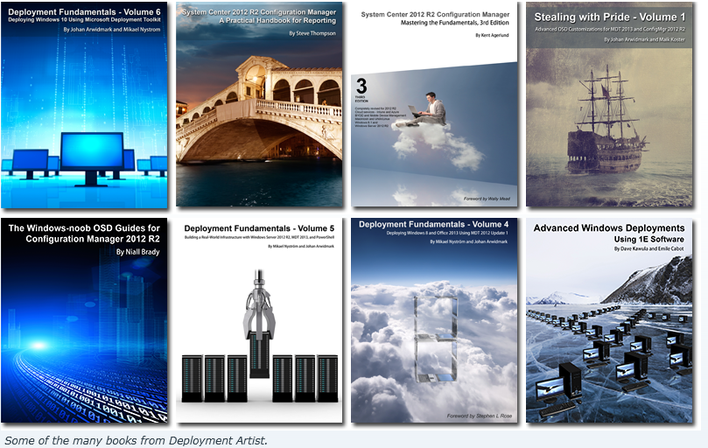

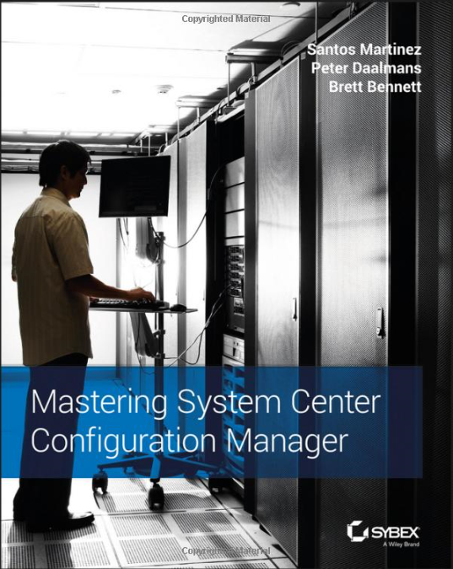
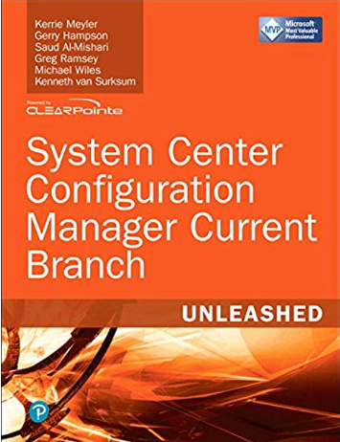
Get Current Stay Current
DeploymentResearch.com
Get on Twitter
Notes:
Over the next hour if you remember only two things, make it DeploymentResearch.com and follow experts on Twitter.
DeploymentResearch.com is Johan Arwidark’s blog.
Second, Twitter is one of the easiest ways to connect and stay current with MVP’s and industry leaders like Ami Arwidmark, Johan Arwidmark, Mikael Nystrom, Gary Blok and others. The Config Manager community is very active on Twitter. If you run into a problem, chances are they have seen it, solved it, blogged it, and tweeted it.

Slide 3
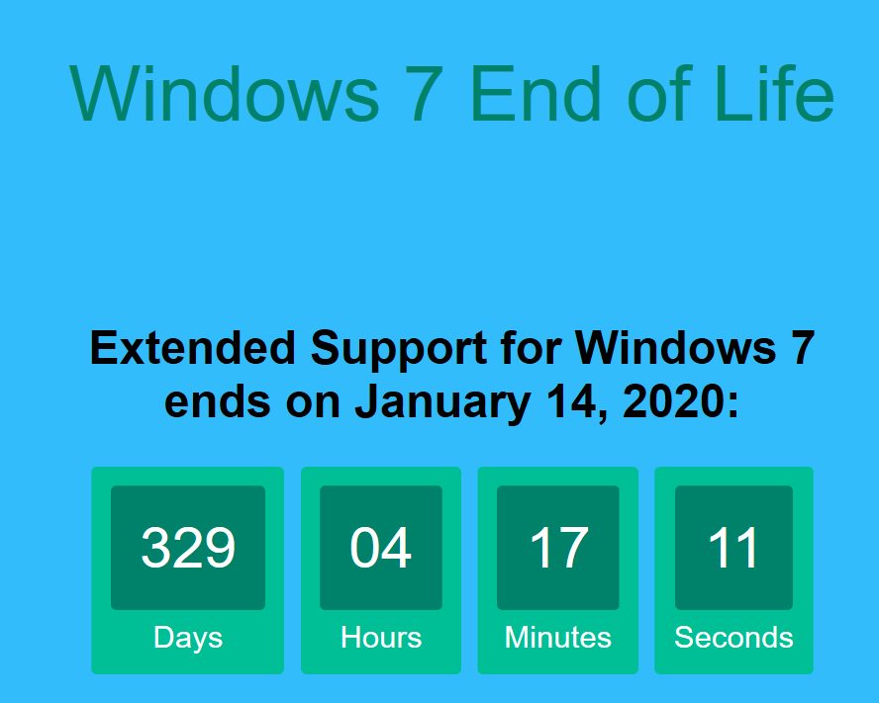
Agenda
Test Lab Environment
Reference Images
Deployments
Notes:
This is our agenda. First, we will setup a lab environment using Hydration Kits. Then, using MDT and the lab we just created, we will create a reference image. For our last stop, we will use Task Sequences in Config Manager to deploy and configure the image.
www.Win7end.com

Slide 4
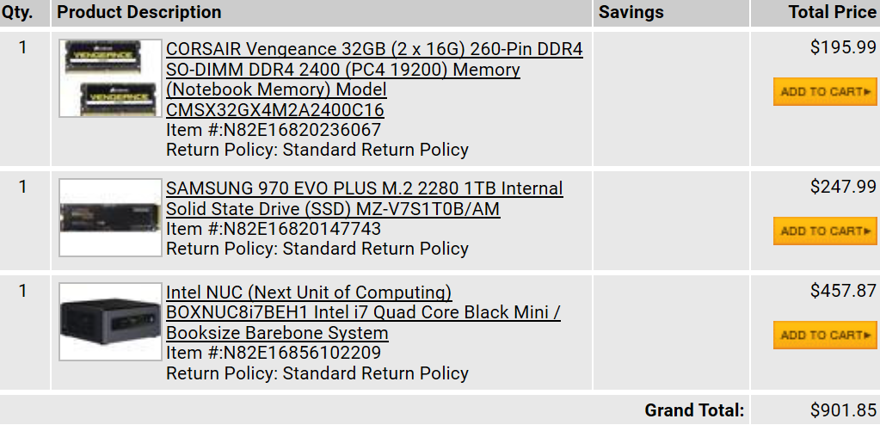
Test Lab Environment – Hardware
Invest in yourself by investing in a lab. Gaining skill + experience + comfort is worth the pain and the expense to build it - Ami Casto
Notes:
Why are we talking about building a test lab? You need to invest in yourself. This is a very small expense for the benefits that you will get from having a test lab. If $1000 is out of your price range, you can add a SSD and RAM to a PC for $500.

Slide 5
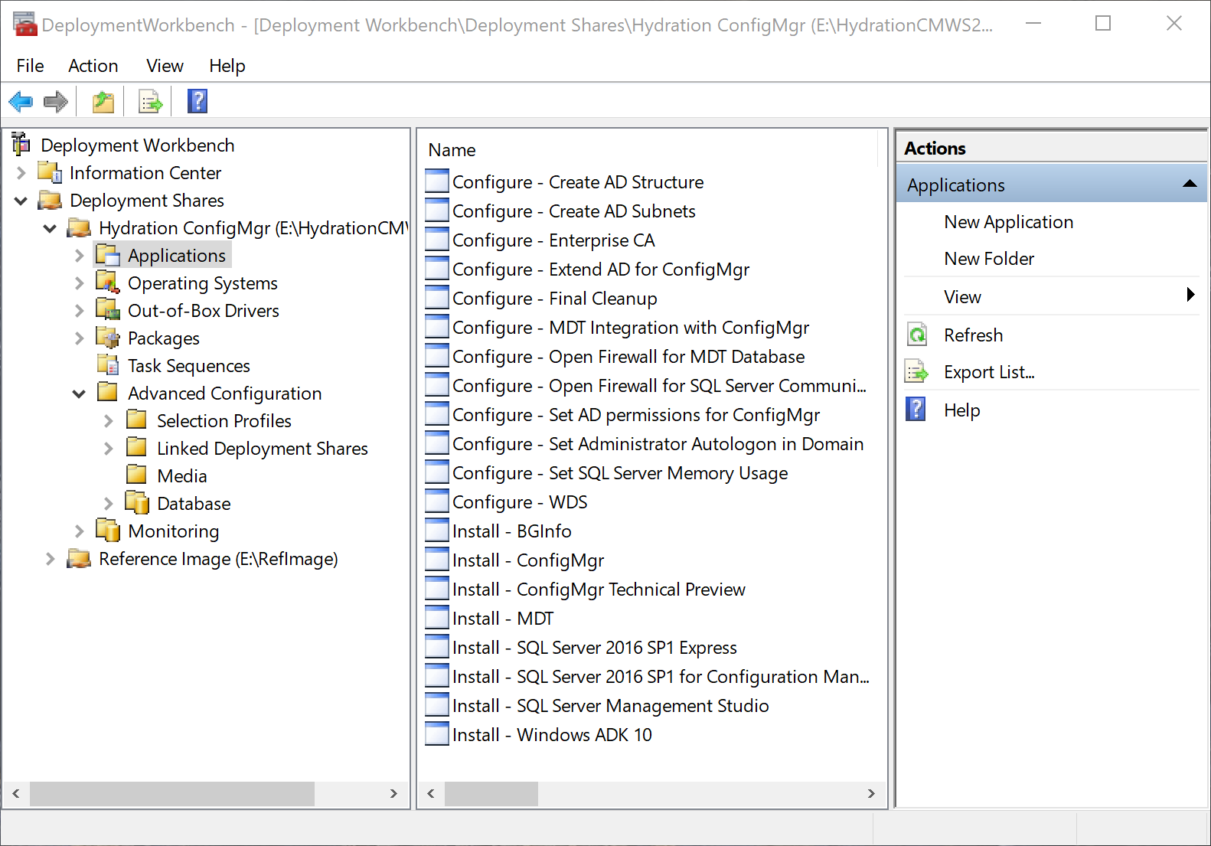
Test Lab Environment – Hydration Kit
Install Windows 10 ADK
    Deployment Tools
    Windows PE
Install Deployment Toolkit
Extract and Run the Hydration Kit Scripts
Populate Deployment Share
Create Deployment Media
Notes:
The easiest way to create your proof of concept or test environment is with a Hydration Kit. Kits are available with the guide books we just showed or deploymentresearch.com. The Hydration Kits are a set of scripts that enable you to build a test lab in three easy steps:
Download the necessary software
Prepare the Deployment Environment
Deploy the virtual machines
What does this look like in more detail? First install Windows 10 ADK and MDT. Extract and run the Hydration Kit Scripts. Download and copy the necessary installation files, Windows Server, Client, SQL, SCCM, Office, etc. to the proper folders in the Deployment Toolkit share. Once the files are copied, start Deployment Workbench, open your Deployment Share, under Advanced Configuration, Media, right-click and choose update media. This will create a bootable ISO file containing all of the files, scripts and Task Sequences in the share. Once the ISO is done we can deploy the lab.

Slide 6
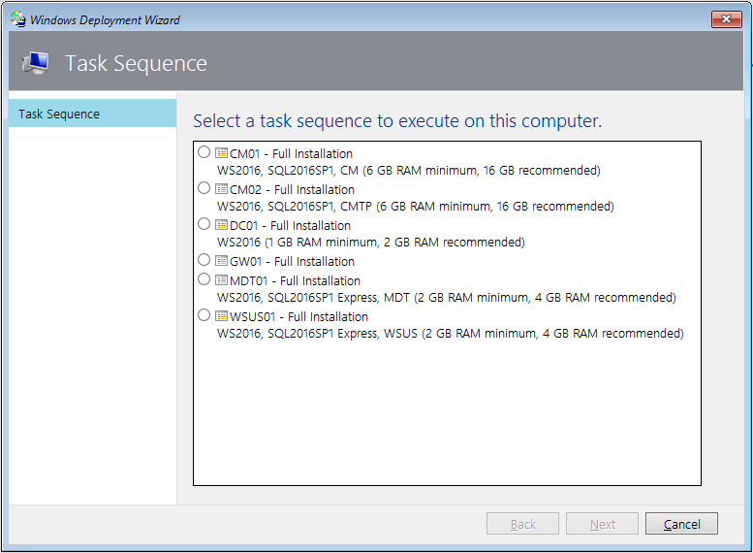
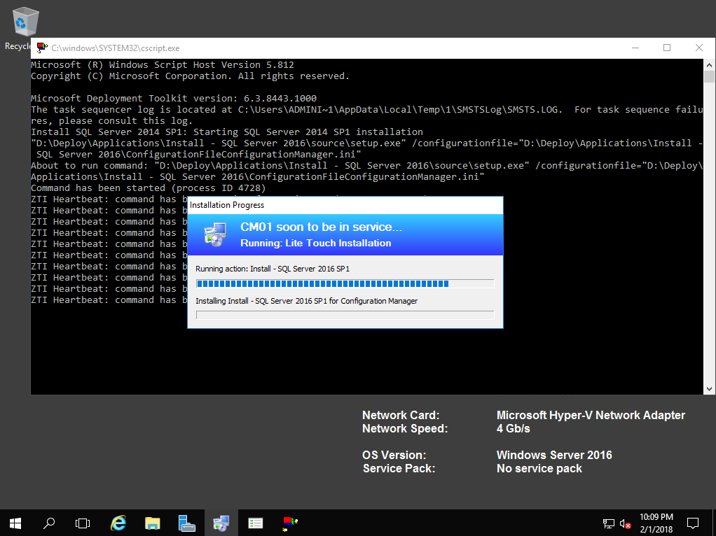
Test Lab Environment – Deployment
Create the Virtual Machines
  Domain Controller
  SCCM Server
  Other Servers as needed
  Clients
Mount the ISO
Start the Domain Controller Task Sequence/Run Configuration Scripts
Start the Remaining Task Sequences
Go to Lunch
Notes:
Use either the PowerShell script for Hyper-V or manually create the following VM’s.
Deploying DC01
Using Hyper-V Manager or VMware Sphere, create a virtual machine with the following settings:
Start the DC01 virtual machine. After booting from HydrationCM.iso , and after WinPE has loaded, select the DC01 task sequence.
Wait until the setup is complete and you see the Hydration Complete message in the final summary. Leave DC01 running while deploying the CM01 virtual machine.
Setup any other VM’s the guide calls for and go to lunch. Setup will complete in 30 – 60 minutes depending on how many VM’s are installing and the speed of your hardware.
Now you have your proof of concept environment. You are ready to test image creation, deployments, and other SCCM functions.

Slide 7
Test Lab Environment – Demo
Demo
Notes:
Show Hydration kit scripts
Show CreateHydrationDeploymentShare.PS1
Show Deployment Workbench
DS\Applications
DS\Operating Systems
Advanced Configuration\Media
Create VM
Start Boot

Slide 8

Reference Image – Overview
Do We Need Them?
Build a Strong Foundation
Use Virtual Machines
  Fast and Flexible
  Rule Out Hardware and Driver Issues
  Quickly move from lab, test, and production
Win 7 was a car you bought outright. Do what you want. Win 10 is a lease. Be careful what you customize. - @mikael_nystrom
Notes:
Cheesy Leaning Tower of Pisa Picture illustrates the importance of creating a solid foundation with your reference image. If you have a bad Reference Image, You’ll have a bad Deployment. Once we forgot to include Adobe Reader in an image. More recently, we had issues with Visual C++ runtimes that prevented Autodesk from installing.
How do you go about creating good images?
Using VM’s to build and test your images is very important. You can quickly set them up, use snapshots to test different scenarios, and rule out issues with drivers. You should use 2 CPU’s, 4GB RAM and RAM disk or SSD for your Reference client.
Image types: Thin Images are considered the new “gold” standard. OS, C++ Runtimes, and .NET Framework. Thin Images are good for dynamic environments or if you have very few apps that need to be installed.
Thick images have everything under the sun installed. The deployment is faster due to the fact that once the deployment is done, the client is completely ready to go. It also supports applications that need a manual installation. Applications need to be Sysprep aware, so no third-party antivirus or Apps that include unique identifiers.
Hybrid Images are the best of both worlds. Ideally you would add applications like Office to your image to allow Updates to apply during image creation and then install additional software after the OS is deployed with SCCM or Group Policy.

Slide 9
Reference Image - Creation
David’s Offline Servicing Method
Johan’s Reference Image Method
OSDeploy.com
OSBuilder – PowerShell Module
Get-OSBUpdate –UpdateCatalogs
Import-OSMedia
Update-OSMedia -DownloadUpdates -Execute
Step 1 – Install Windows 10 ADK and MDT
Step 2 – Create New Deployment Share
Step 3 – Import the Windows 10 operating system
Step 4 – Import Cumulative Updates (Optional)
Step 5 – Add applications (Optional)
Step 6 – Create/Edit Task Sequence
Step 7 – Configure/Update the Deployment Share
Step 8 - Create Windows Reference Images
Notes:
Johan’s Method
Done
Right-Click New Share
Import Full Set of Source Files from iso or OSBuilder
Import CU if needed, ideally we update the OS with OSBuilder or WSUS
Add applications like C++ runtimes, Latest .NET
Key points are:
No Product Key
No Admin Password
All customizations should be done in State Restore
Set Power Management to High Performance for faster build times
Configure the Deployment Share
Bootstrap.ini Username/Password for the share is in clear text another reason to use the demo PC
CustomSettings.ini Set your WSUS server here
Update Deployment Share
Create VM and capture image

Slide 10
Reference Image – Demo
Demo
Notes:
Import Windows
Task Sequence
Start Capture

Slide 11
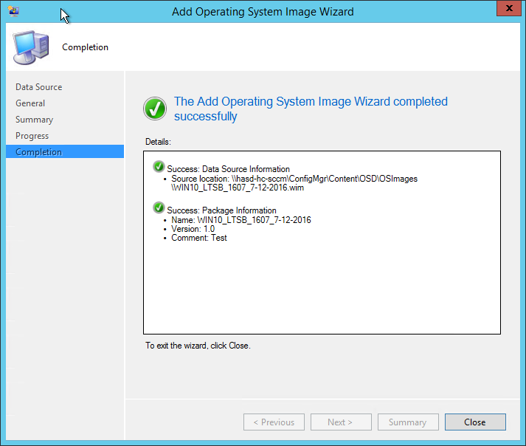
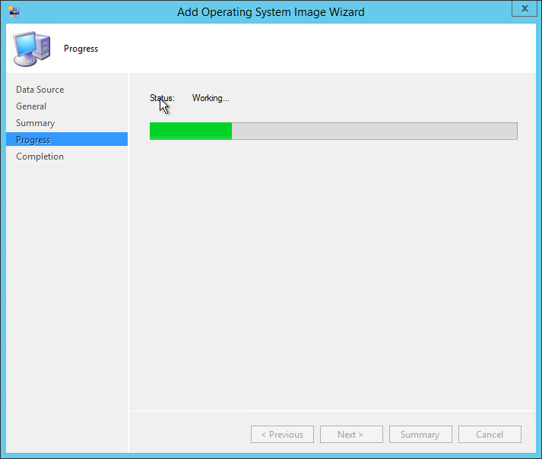
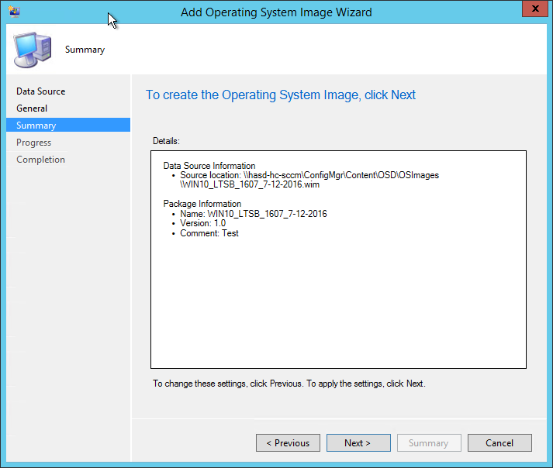
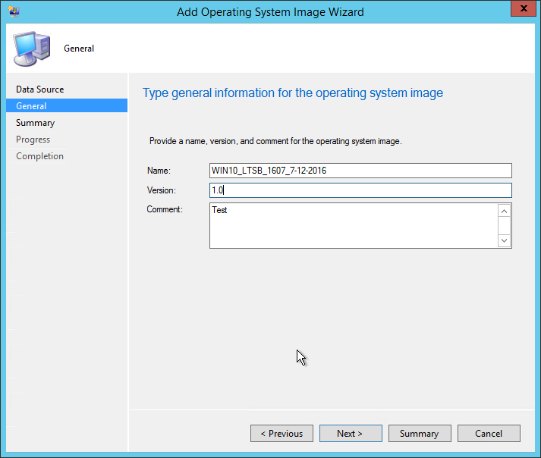
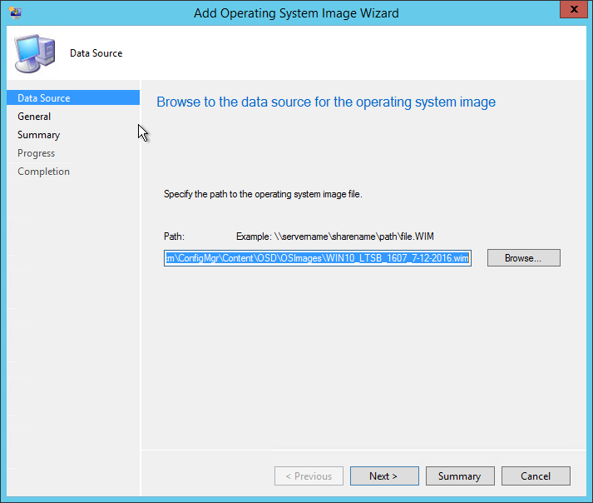
Deployments - Images
Import your Reference Image
Distribute the Image
Notes:
Import the image from Software Library\Operating Systems\Operating System Images
Distribute Content
Next we’ll add drivers.

Slide 12
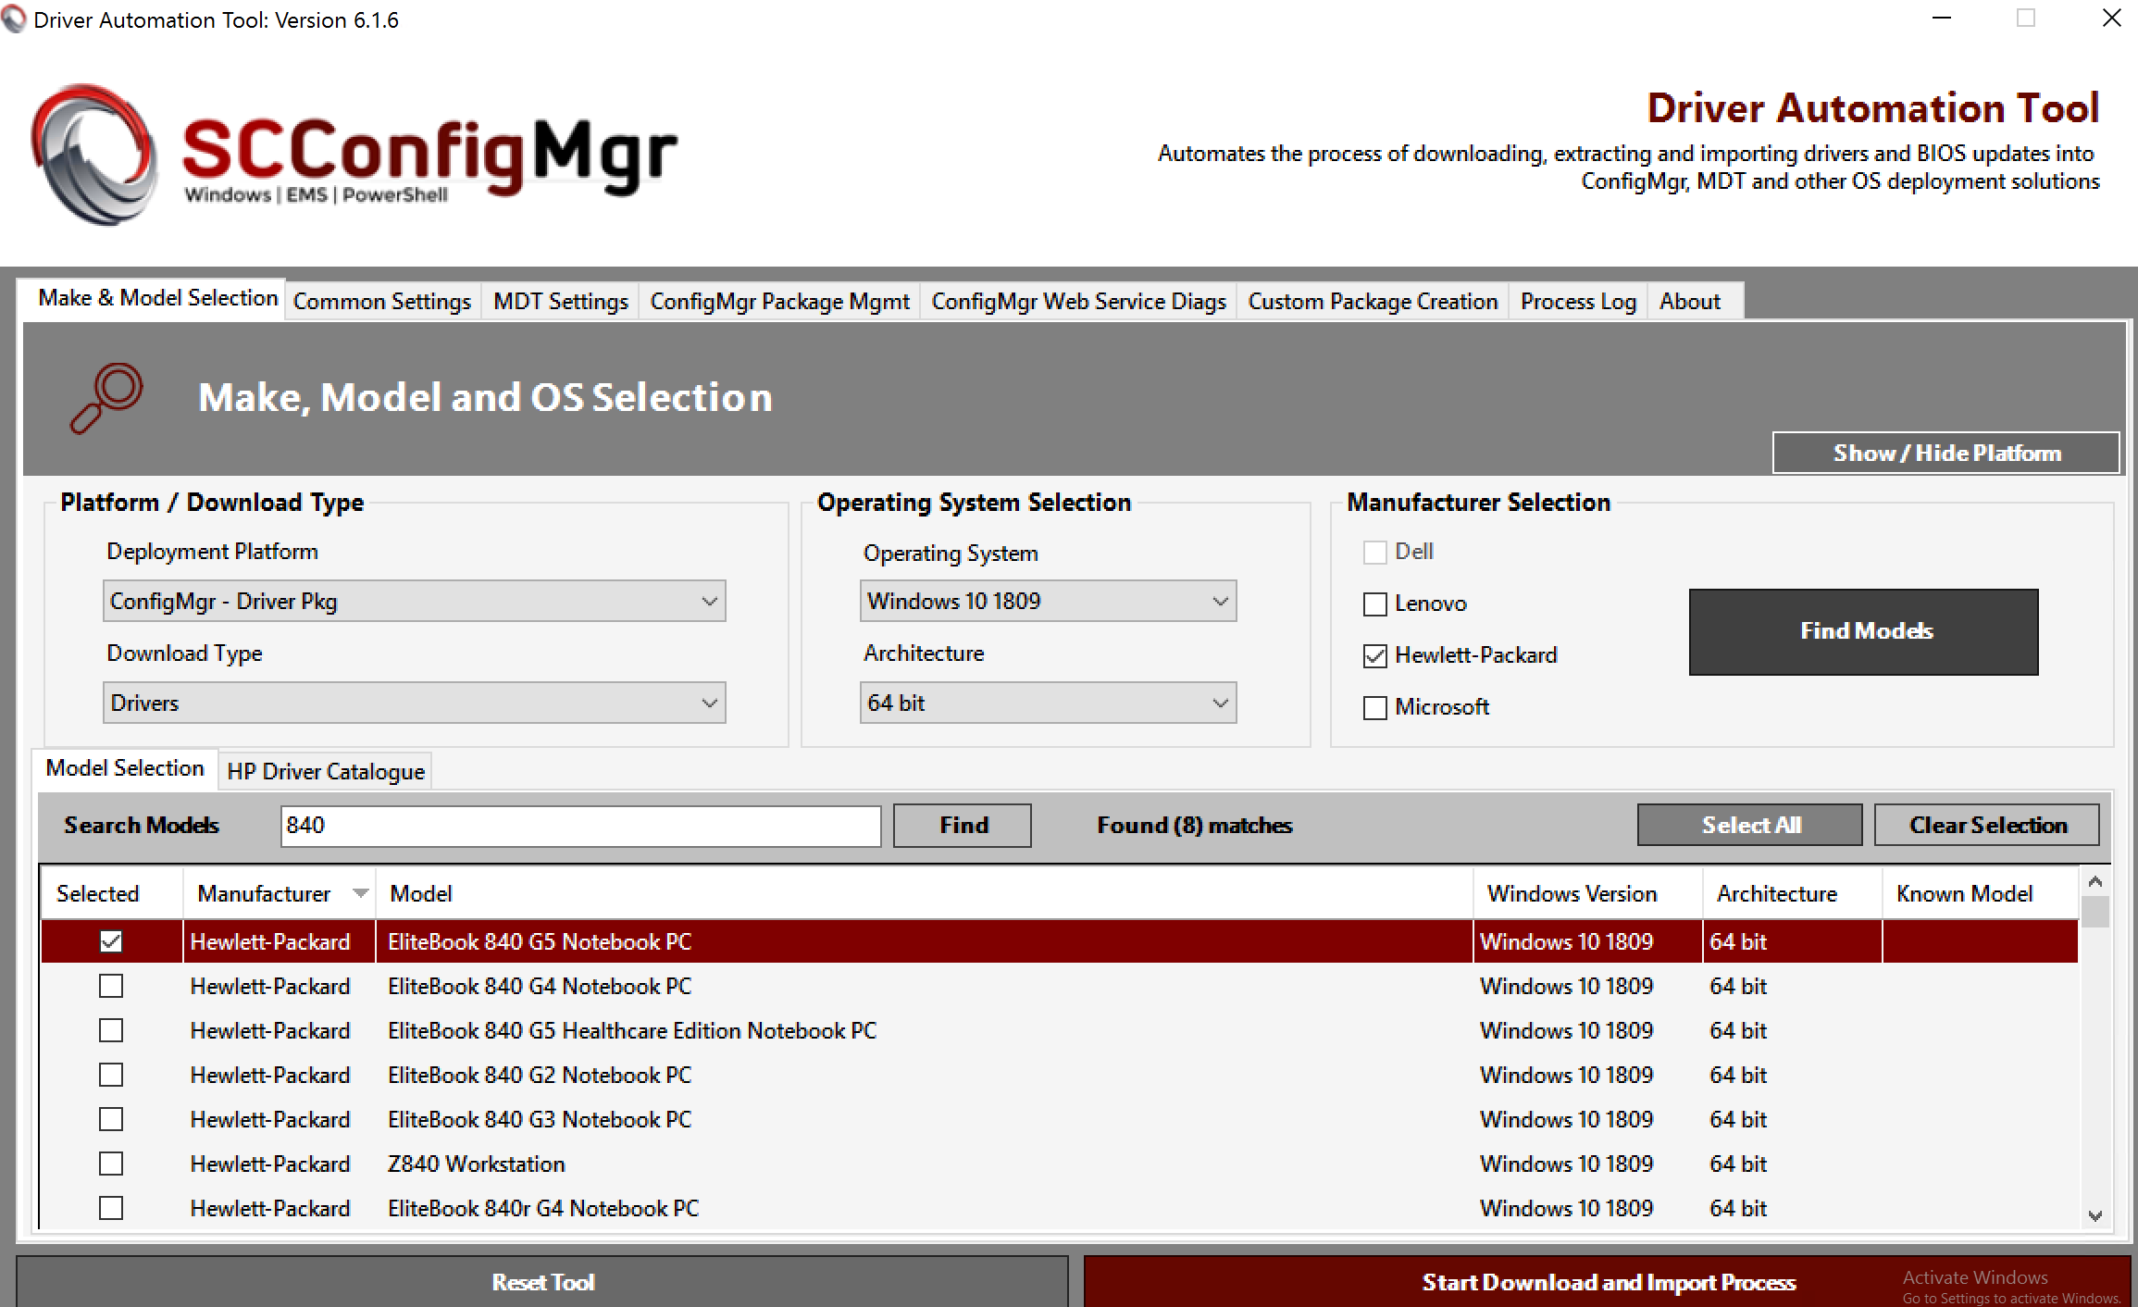
Deployments - Drivers
Finding the Drivers
  Driver Automation Tool
  Search for ConfigMgr Packages
Adding the Drivers
  Folder Structure – Jason Sandys
  Import Drivers
  Distribute the Driver Package
Notes:
HP, Dell, and Lenovo offer easy to use tools for downloading drivers. If you can’t find the drivers, try the vendor or the Microsoft Update Catalog. Create OS\Make\Model folder structure or whatever works for you. Import the drivers and create Administrative Categories for the drivers, like Windows 10 – Microsoft Surface Pro 4. Right-click on the Package and select Distribute Content.

Slide 13
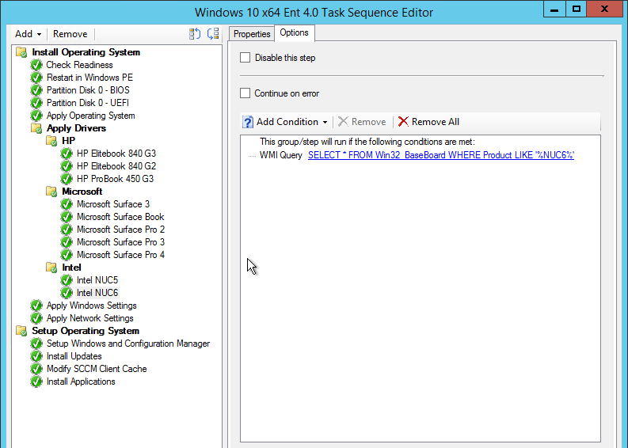
Deployments – Task Sequence
Create
Edit
  Add Driver Selections – WMI
  Add Customizations – Garytown.com
  Add Applications
Deploy
Notes:
Now we have a Reference Image and we have drivers available.
Under Software Library, Task Sequence, Create a new Task Sequence and follow the wizard.
Name and select the Boot Image
Select the reference image Package. Set Admin password and other options through the wizard.
Once you have a Task Sequence, you’ll want to edit it.
Apply Drivers – Free for all vs. Controls – WMI Queries
http://ivan.dretvic.com/2012/10/common-wmi-queries-i-have-found-useful/
Add
Deploy the Task Sequence when you are done.

Slide 14
Deployment – Demo
Demo
Notes:
Show Blank Task Sequence and Customized Task Sequence
Deploy

Slide 15
Resources
Documentation
  Windows Build Versions - https://support.microsoft.com/en-us/help/4043454
  System Center Configuration Manager - https://docs.microsoft.com/en-us/sccm/index
  Deployment ToolKit - https://docs.microsoft.com/en-us/sccm/mdt/
Training
  Channel 9 - https://channel9.msdn.com/Events/ignite
  Microsoft Virtual Labs - https://www.microsoft.com/handsonlabs/SelfPacedLabs
  Microsoft FastTrack - https://fasttrack.microsoft.com
  Modern Desktop Deployment and Management Lab - https://docs.microsoft.com/en-us/microsoft-365/enterprise/modern-desktop-deployment-and-management-lab
Twitter
  Mikael Nystrom - @mikael_nystrom
  Johan Arwidmark - @jarwidmark
  Harjit Dhaliwal - @hoorge
Websites/Blogs
  http://deploymentresearch.com
  http://deploymentbunny.com/
  https://www.windows-noob.com
  http://ccmexec.com/
  https://garytown.com/
  https://sccmf12twice.com/
  https://www.facebook.com/groups/techkonnect/
Events
  Midwest Management Summit - http://mmsmoa.com
  Microsoft Ignite - https://ignite.microsoft.com
  IT/Dev Connections - http://itdevconnections.com
  Microsoft Tech Community - https://techcommunity.microsoft.com/
Notes:
Closing

